Slide 1
A Mini Project Proposal Defense on LPG Gas Leakage Detection and Monitoring system
Aashish Timalsina(019-401)
Bikesh bhatta(019-421)

Slide 2
Contents
Background
Objectives
Methodology
Schedule
Estimated Budget
Expected Result
Conclusion
References

Slide 3

BACKGROUND
Today, Liquefied Petroleum Gas ( LPG ) is the most commoncooking fuel throughout our country. With the increase in the numberof people using this fuel, it is the need of the hour to provide somesafety standards. Here is Gas Leakage Detector which is used to detectthe leakage of gas and it can protect us from gas damage.
Today, Liquefied Petroleum Gas ( LPG ) is the most common cooking fuel throughout our country.
With the increase in the number of people using this fuel, it is the need of the hour to provide some safety standards.
Here is Gas Leakage Detector which is used to detect the leakage of gas and it can protect us from gas damage.
Now the world is evolving with technology, so it is necessary to use technology, if possible, in every case. LPG gas to resolve the accident occurred we can prevent it through technology. The system is based on a microcontroller, which uses gas sensors as well as Thing speak Interface, display and buzzer. It is designed for LPG Gas Leakage Monitoring and Alert System using ESP-32 Mega with MQ6 sensor. The uses of the ESP-32 microcontroller with ESP-32, provide a suitable platform for implementing an embedded control system and it is possible to modify it to meet our future requirements easily and quickly.

Slide 4
OBJECTIVES
To detect the leakage of LPG gas in a closed environment, if any
To inform the user about the leakage of gas via Monitoring system
To activate the alarm unit to inform neighbors about the gas leakage.
Produce a sound alarm upon gas leak and stop the alarm once gas leak.
Send the Email to alert the user about gas leakage

Slide 5
METHODLOGY
Include block diagram
Working mechanism
Flow chart
Hardware and software etc.

Slide 6
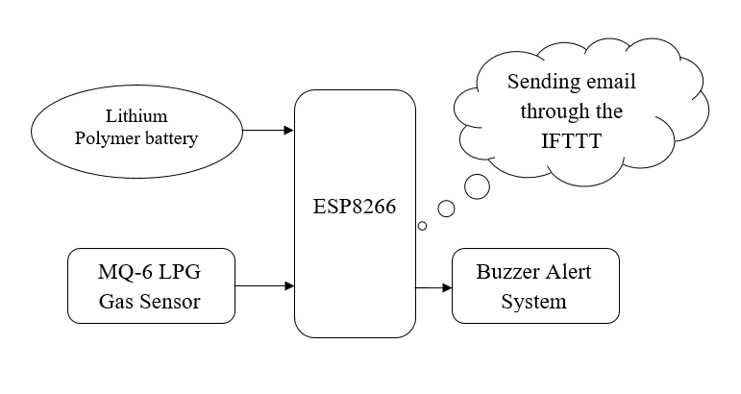
BLOCK DIGRAM
ESP 32

Slide 7
Working Mechanism
In gas leakage detection process, any gas leakage is checked by gas sensor (MQ-6) which is interfaced with ESP-32.
When leakage is detected, sensor read threshold value same time it informs ESP-32 if gas values is maximum then set up threshold value about the gas leakage by sending Email through thing-speak interface by using SMTP sending via messages , turning on the buzzer an inform the user.

Slide 8
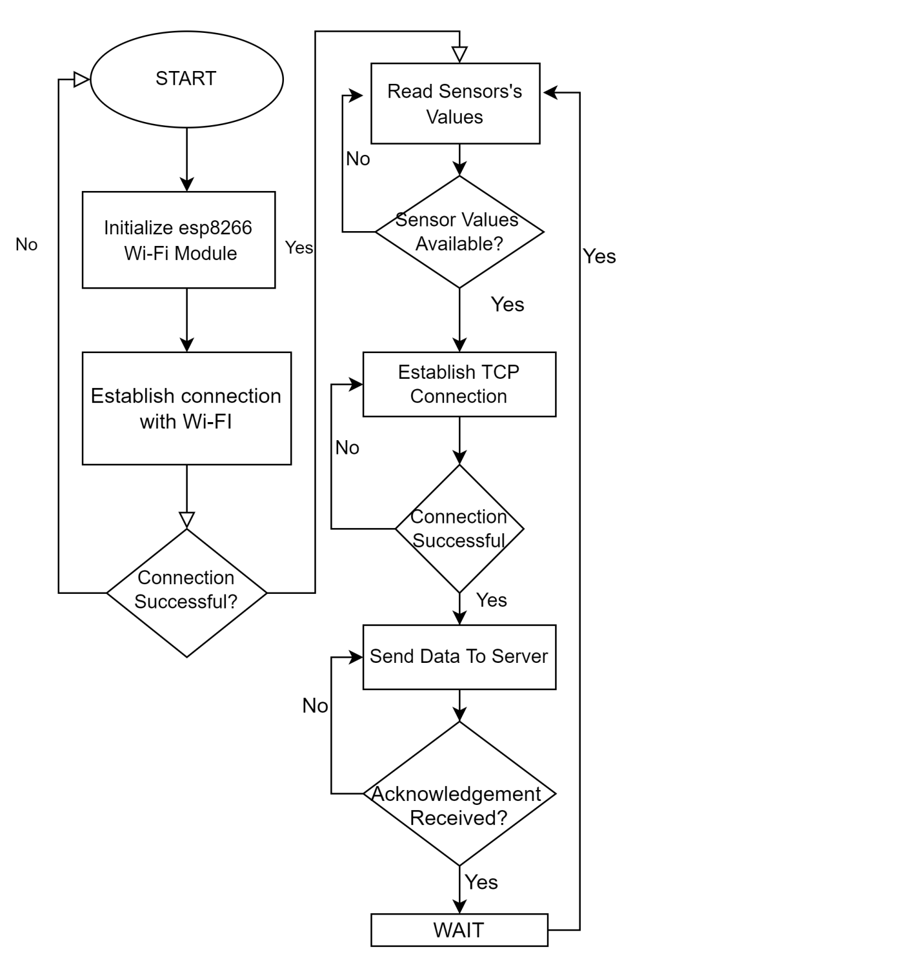
ALGORITM

Slide 9
SCHEDULE(GANT CHART)
S.N. | Tasks | Week
1 | Discussion and researching about the project | 1
2 | Buying components and assembling them | 1
3 | Coding | 1
4 | Testing | 1

Slide 10
Hardware and Software
LPG SENSOR (MQ-6)
ESP-32
LCD Display (20*4)
Buzzer
Thing speaks
IFTTT
Jumper wires

Slide 11
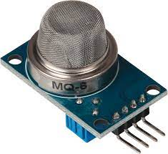
Gas sensor ( MQ-6)
The MQ-6 is a semiconductor gas sensor that detects the presence of LPG, Isobutene and Propane gas.
The sensor can operate at temperatures from -10 to 50 degree and consumes less than 150mA at 5V.
Features:
High sensitivity to LPG, Isobutene, Propane
Small sensitivity to Alcohol, Smoke
Detection range: 100-10000 ppm
Fast response time: <10s

Slide 12
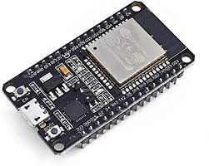
ESP-32
Specification:
The ESP32 is dual core, this means it has 2 processors.
It has Wi-Fi and Bluetooth built-in.
The clock frequency can go up to 240MHz and it has a 512 kB RAM.
This particular board has 30 or 36 pins, 19 in each row

Slide 13
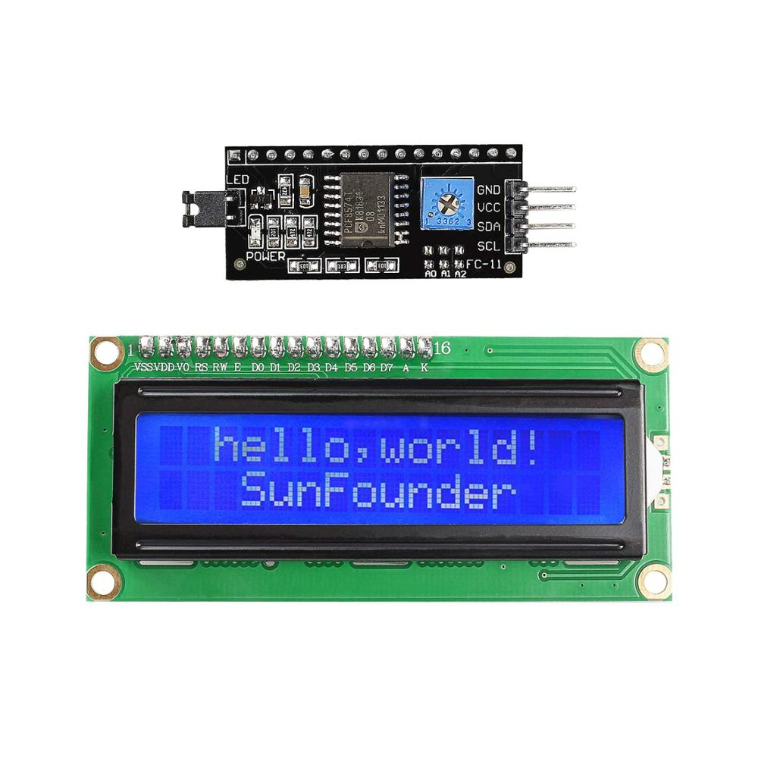
I2C Lcd Display
A 16x2 LCD means it can display 16 characters per line and there are 2 such lines. In this LCD each character is displayed in 5x7 pixel matrix. This LCD has two registers, namely, Command and Data. This is standard HD44780 controller LCD.

Slide 14
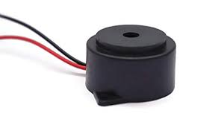
BUZZER
The buzzer is a sounding device that can convert audio signals into sound signals. It is usually powered by DC voltage. It is widely used in alarms, computers, printers and other electronic products as sound devices.

Slide 15
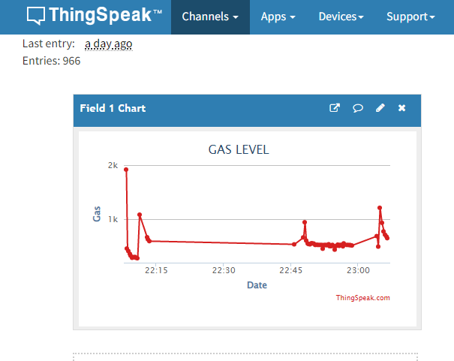
Thing speaks
Thing Speak enables sensors, instruments, and websites to send data to the cloud where it is stored in either a private or a public channel.
Thing Speak stores data in private channels by default, but public channels can be used to share data with others.

Slide 16

ARDUNIO
The program is written in Arduino library.
The IDE is Arduino as well.
Supporting libraries such as I2C lcd and keypad is utilized.

Slide 17
EXPECTED RESULT
In gas leakage detection process, any gas leakage is checked by gas sensor (MQ-6) which is interfaced with ESP-32.
When leakage is detected, it informs the user about the gas leakage by sending Email through thing-speak interface by using SMTP sending via messages, turning on the buzzer.

Slide 18
FEASIBILITY ANALYSIS
Future Scope
When there is a leakage in gas cylinder the main supply in home is automatically cut off by using home automation.
Automatic payment should be paid by after cylinder booking from user bank account.

Slide 19
Estimate Budget
S. N | Hardware | Quantity | Rate | Amount
1 | ESP32 | 1 | RS.800 | RS.800
2 | Lithium Polymer battery | 1 | RS.100 | RS.100
3 | LCD 16*2 | 1 | RS.600 | Rs.600
4 | Jumper Wire(40pcs/pkt+Buzzer) | 1 | RS.200 | RS.200
5 | Male & Female Header (40 pin) | 2 | RS.100 | RS.200
6 | Glue stick | 1 | RS.50 | RS.50
7 | Adapter | 1 | RS.250 | RS.250
Total |  |  | 2350

Slide 20
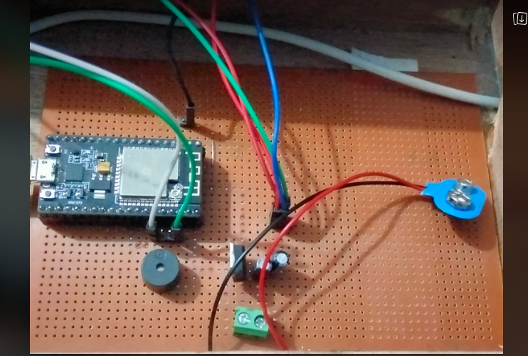
Hardware simulation
This figure shows the “LPG GAS Detction AND MONETRING SYSTEM” with the following dimension :
Length: 18 inches
Width: 12 inches

Slide 21
CONCLUSION
By implementing this project, we have minimized the risk of hazards of LPG gas leakage.
We have implemented the automatic system which ensure the safety of customer. Also, we have minimized the cylinder replacing time.

Slide 22
REFERNCES
Kumar Keshamon, Sabbani Hemanth, “Smart Gas Level Monitoring, Booking & Gas Leakage Detector over IoT”, 2017 IEEE 7th International advance Computing Conference
Saurabh Joshi, Rohit Patil, “Automatic System for LPG Refill Booking and Leakage Detection”, Vol-3 Issue-2 2017IJARIIE- ISSN(O)-2395-4396
Ajay Kumar, Mukesh Kumar, Balwinder Singh, “Designing and Implementation of Smart LPG Trolley with Home Safety”, 2016 2nd International conference on Next Generation Computing Technologies (NGCT-2016) Dehradun

Slide 23

THANK-YOU

